Slide 1
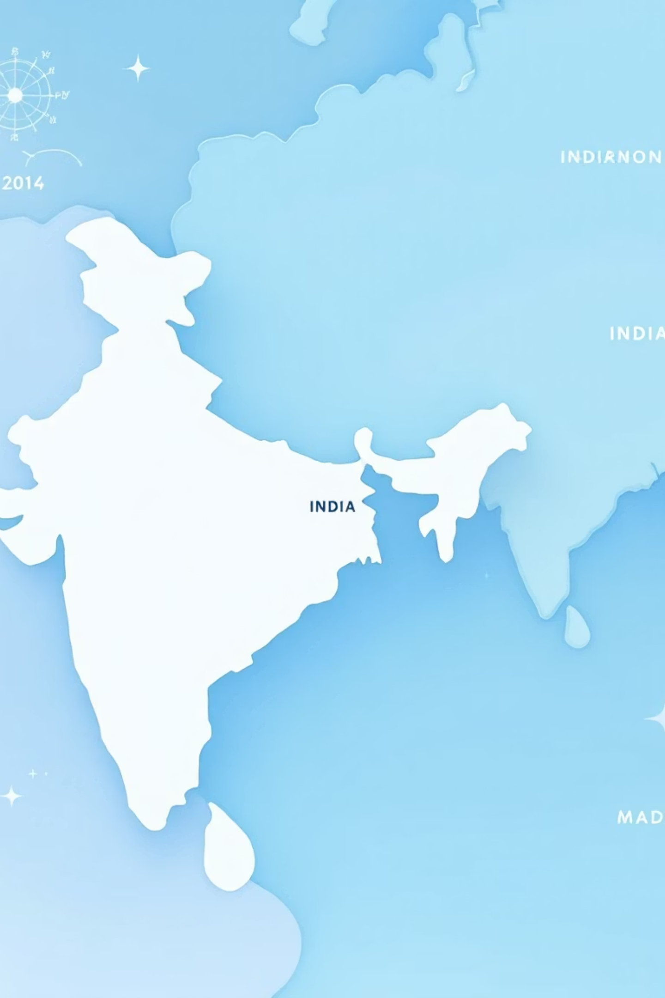
Interactive India Tourism Map
Leveraging Data for Accessible and Sustainable Travel
A submission for the NASA Space Apps Challenge 2025.

Slide 2
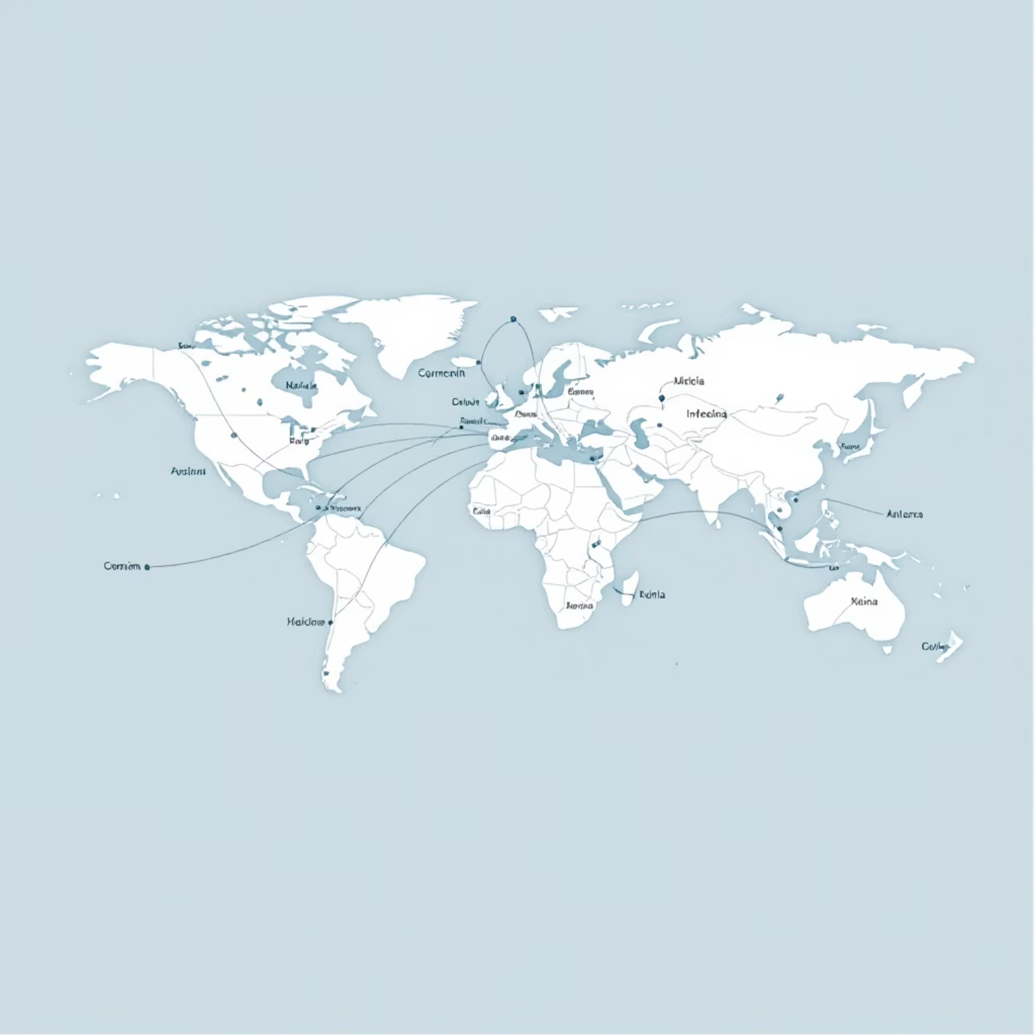
The Challenge: Engaging and Accessible Tourism Data
Tourism is a powerful economic and cultural driver, yet travel planning information is often fragmented and hard to navigate. We aimed to solve this by creating a unified, data-rich platform.
Our mission was to transform raw data into an intuitive, visually engaging tool for tourists, focusing on three core pillars: Culture, Safety, and Sustainability.
1
2
3
Cultural Immersion
Travel Safety
Sustainable Planning

Slide 3










What We Developed: State-Level Insights
Cultural Information
Interactive Map Interface
Key historical sites, local festivals, and unique regional cuisines.
A clean, responsive map of India where every state boundary is clickable.
Top Tourist Destinations
Curated lists of must-visit places and off-the-beaten-path locations.
Best Time to Visit
Seasonal weather patterns and optimal travel windows for each region.
Safety and Crime Rates
Data-driven insights on safety metrics to help tourists make informed choices.
Upon selection, users receive a comprehensive overview, blending travel tips with critical data points.

Slide 4

How It Works: Technology Stack
The platform is built on modern, performant web technologies to ensure a seamless user experience across all devices.
1
Frontend Foundation
React & Vite: Used for rapid development, component-based architecture, and highly responsive rendering.
2
Seamless Navigation
React Router: Enables smooth, single-page application experience when moving between the main map and state detail pages.
3
Data Structure
JSON Database: A lightweight, easily maintainable structure containing all information for Indian states, locations, and statistics.
4
Core Interaction
Users click on a state map graphic which triggers a data fetch and display of state-specific travel insights.

Slide 5
Impact: Fostering Better Travel
Interactive & Engaging Experience
Promotes Cultural Exchange
Transforms static, overwhelming data tables into a visually appealing and intuitive map interface, boosting user retention.
Highlights the diversity and richness of India's culture, driving conscious and respectful travel planning.
Empowers Safe Exploration
Supports Informed Decisions
Integrating real-time and historical crime data helps travelers assess risks and choose safer routes and destinations.
By centralizing key information, we make travel planning efficient, responsible, and sustainable.

Slide 6
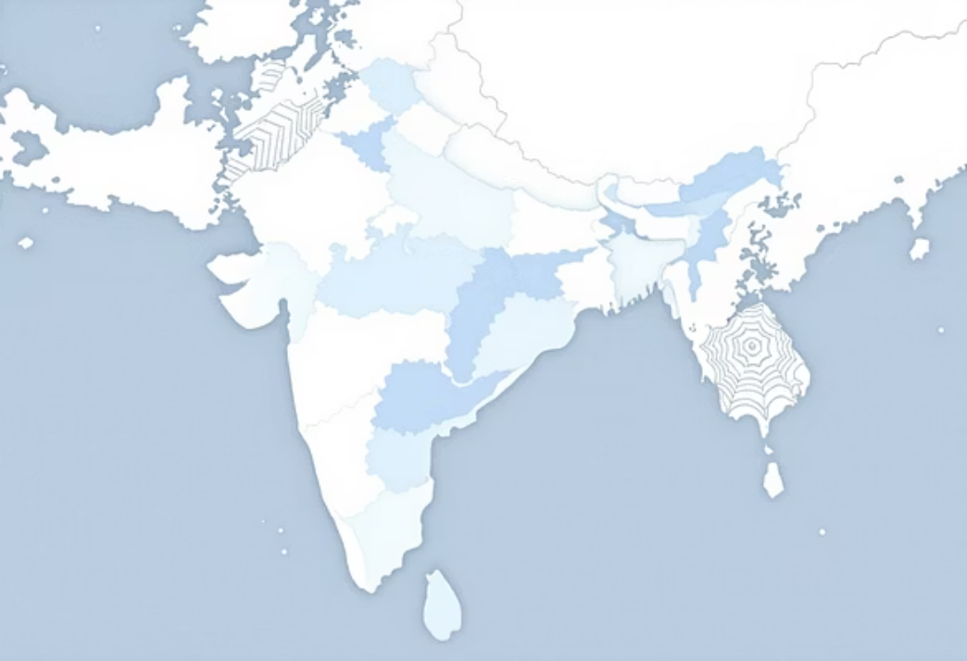

Visual Showcase: Map & Detail View
The two key views: the Homepage Map for high-level selection, and the State Detail Page providing actionable travel insights.

Slide 7

We are proud to present our solution for the NASA Space Apps Challenge 2025.
We welcome your feedback and questions!
Thank You!

